Slide 1
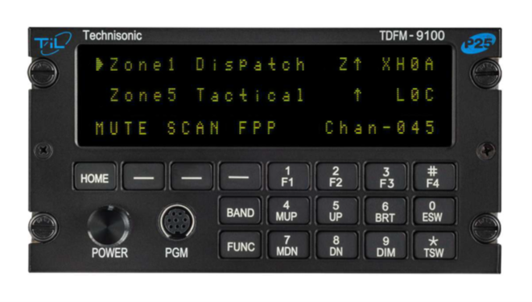
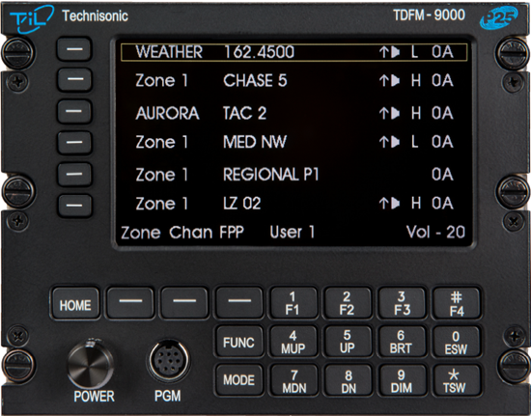

Welcome
TDFM-9000
Operators Training

Slide 2
Mr. Jim Huddock
Technisonic
Business Development Manager
Federal / OEM/ Military
Jhuddock@til.ca
Tel: (612) 231 9020
Introductions

Slide 3


  Overview of P25
  TDFM-9000 Architecture
  Specific Layout
  Basic Operations
  Advanced Operations
  Supervisory Operations
  Intro to Motorola CPS
    Revision management
    Cable Info
    Read/Write
    Input Channel
    Trunking Considerations
  NIFOG Code-plug
  Field Support
Course Outline

Slide 4

While we are all Aviators, A&P’s and Avionics Specialist, always remember, the Technisonic TDFM line of Civil Support radios is
LAND MOBILE RADIO,
in an Avionics body!
Civil Support Radios

Slide 5
A Little History
Since 1979 Technisonic has focused its efforts on the development of aeronautical band VHF ground equipment and special mission airborne RF and audio communications systems. Technisonic is now well-established as a leader in the development of aviation-related special mission communications products.
Company Facts:
Founded in 1979
Employs 60 plus people engaged in all aspects of engineering, fabrication, production, quality, and administration.
Established distributor relationship – Dallas Avionics in 1995
Offered our first tactical radio in 1994
Notes:
Developed as the natural progression for our industry leading TDFM-7300 series radio,
The ALL New 9000 series radios – maintain the same size and dimensions of the 7300,
replacement, or cockpit commonality simple –
while providing an unparalleled leap in capability

Slide 6
P25
RADIO 101 P25 Explained

Slide 7
(P25) was established to address the need for common digital public safety radio communications standards for first-responders and homeland security/emergency response professionals
P25 is the countries attempt at a radio interoperability standard. Originally designed to support four bandwidths, P25 has continued to evolve since its first deployments back in the early 90’s
Core Bandwidths - VHF FM 136 -174MHz Federal
UHF-LO 380-520MH Civil – Muni / Federal
7/800 764-870MHz Statewide
Project 25

Slide 8
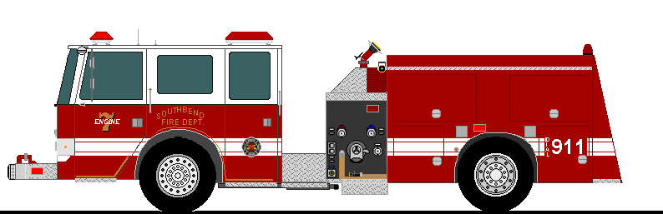
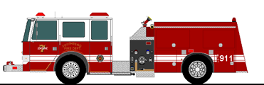

Before P25, every manufacturer utilized its own signaling to tell their radio when to open squelch and pass traffic. In short, the systems were Proprietary. This caused significant problems in emergency and disaster situation.
Motorola Ville
Harris Berg
Tait City
Imaging a 3 Alarm Fire, Where three Different Fire Departments responded to the same large fire. Each truck coming from a different town, operating radios from a different manufacturer. In many cases this led to Truck #1 being unable communicate with truck two or three. This resulted in dangerous and possibly fatal breakdown of communications in Critical Situations.
Something had to be done, That something was a new radio standard call Project 25, or P25.
RADIO 101 P25 Explained

Slide 9




What is P25: Simply put, P25 is a communication standard shared across radio manufacturers
that ensures that one manufacturers radios transmission will be received by another manufacturers
radio. By adhering to the standard, now the critical Interoperability previously missing is now established
RADIO 101 P25 Explained

Slide 10
P25 Architecture
Land Mobile Radio is divided into two core architectures
Conventional and Trunked. Each architecture is unique and employs different terms and technologies.
LMR
Conventional
Trunked

Slide 11

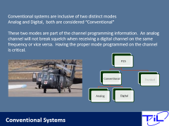
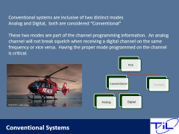
Conventional systems are inclusive of two distinct modes
Analog and Digital, both are considered “Conventional”
These two modes are part of the channel programming information. An analog channel will not break squelch when receiving a digital channel on the same frequency or vice versa. Having the proper mode programmed on the channel is critical.
P25
Conventional
Analog
Digital
Trunked
Conventional Systems

Slide 12

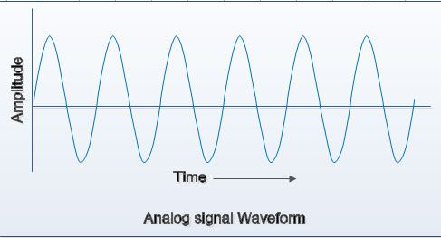


The P25 Standard also established Conventional Signaling “MODES”
Analog and Digital
Analog is most common, 85% or so of LMR radio signals
Analog consist of a long Wave type signal, as you get further
from the source, more and more static will be heard until
finally the station is no longer usable
Digital represents only about 15% of radio traffic at present
Digital consist of a Block style wave and is either 100% usable
or 0% usable. Think of your Digital TV freeze.
RADIO 101 P25 Explained

Slide 13
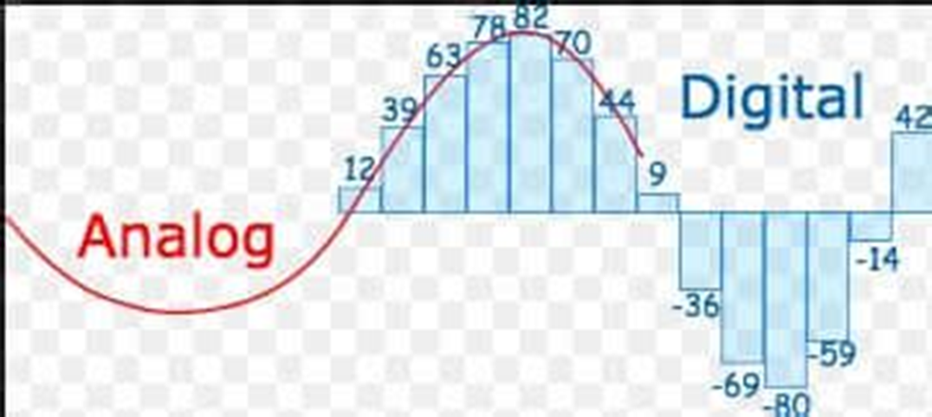

Motorola ISM’s
Analog = Non- Astro
Digital = Astro
RADIO 101 P25 Explained

Slide 14
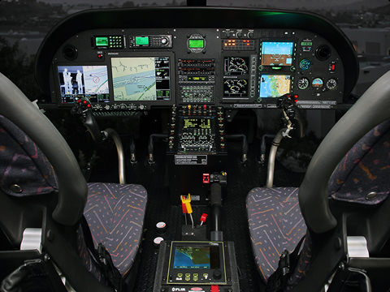
Unlike your Aviation AM radios, FM radios allow for far more flexibility in the channel. In analog channel set ups, you must define the following attributes for the channel to work properly.
Receive Frequency
Transmit Frequency
TPL – Tone Private Line (PL Tone) aka (CTSS)
DPL – Digital Private Line (DPL TONE)
Mode – (Analog) (Digital) ( Mixed)
Conventional System Formats

Slide 15
Receive / Transmit Frequencies -
Conventional systems have the capability of supporting both-
  Simple Frequencies – RX/TX frequencies are the same such as 155.250
  Duplex Frequencies RX/TX frequencies are different. RX 151.250 TX 167.500
When setting up your frequencies, especially while utilizing the Front Panel Programming
capability, careful attention must be paid to this parameter.
Conventional Systems

Slide 16


A “Simplex” Channel has the same Rx and TX frequency different. This is basic “Line of Site” radio. You are talking directly to the other radio. “walkie talkie”
Channel 1
Rx = 136.00
Tx = 136.00
Channel 1
Rx = 136.00
Tx = 136.00
Analog Frequencies – Simplex or Direct

Slide 17
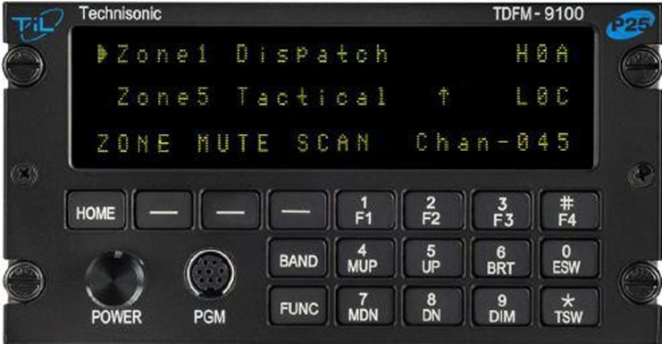
A Direct or Simplex Frequency is denoted by an up arrow
displayed to the left of the Channel name.
Analog Frequencies – Simplex or Direct

Slide 18


Channel 1
Rx = 136.00
Tx = 154.250
Channel 1
Rx = 136.00
Tx = 154.250
A “Repeater” Channel has different Rx and the TX frequencies. Since a radio cannot send and receive on the same frequency at the same time, two separate frequencies are used on Repeater or Duplex channel
Analog Frequencies Duplex or Repeater

Slide 19

Channel 1
Rx = 154.250
Tx = 136.000
Channel 1
Rx = 136.00
Tx = 154.250
Channel 1
Rx = 136.00
Tx = 154.250
You are always utilizing someone's system when on a
Repeater or Duplex frequency. Towers are placed strategically to ensure coverage on the ground.
Analog Frequencies Duplex or Repeater

Slide 20
Channel 1
Rx = 154.250
Tx = 136.000
Channel 1
Rx = 136.00
Tx = 154.250
Channel 1
Rx = 136.00
Tx = 154.250
A “Repeater” is used to reach beyond line of site, or to extend the range of Portable radio, Remember, this is land mobile radio, Portable radio are only meant to reach the closest tower, not to travel long distances.
Analog Frequencies Duplex or Repeater

Slide 21


TALK AROUND or GOING DIRECT on a REPEATER CHANNEL
Some radios allow a “ DIR” (Direct or Talk Around) function, This feature allows you to By-Pass the tower with the touch of a button and essentially set up a Simplex or direct connection.
KEY: Both Parties must agree to go direct or Talk Around for this feature to properly work.
This is Global Feature on the APX module, by allowing a direct button the operator is essentially by-passing not just the selected channel, by ALL Repeater Channels programmed. For this reason, unless highly knowledgeable and experienced,.
We do not recommend enabling the direct feature or button in your programming.
Analog Frequencies Going DIRECT

Slide 22
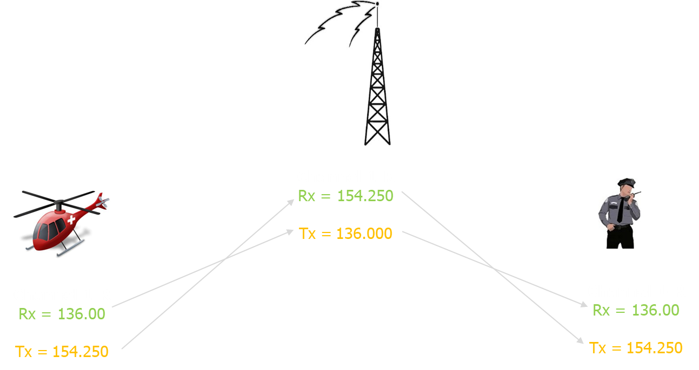

A better option to allow Talk Around is
to program a Simplex Channel as the next channel in the code plug.
Simply program a simplex channel utilizing the channels receive frequency
Channel 1 – R
Channel 1
Channel 1
Direct Version
Rx = 136.00
Tx = 136.000
Channel 1 Direct Version
Rx = 136.00
Tx = 136.000
Analog Frequencies Going DIRECT or Talk Around

Slide 23
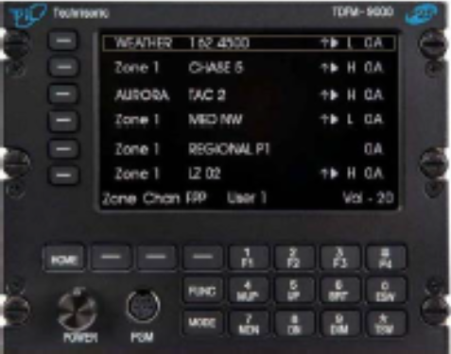
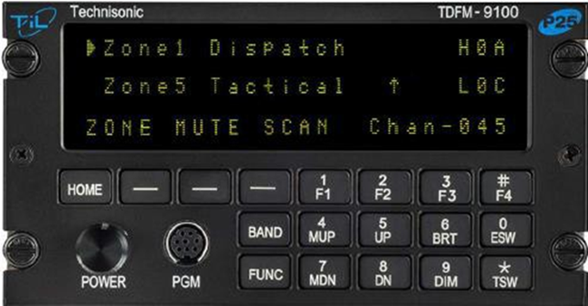
A Duplex or Repeater frequency is denoted by the absence of the arrow.
Analog Frequencies – Simplex or Direct

Slide 24
PL Tones are a way of limiting the squelch break of your radio while on a common Analog frequency. By enabling a PL tone, the sending radio and the receiving radio will only break squelch for each others transmissions, other non associated traffic will not be heard.
Aircraft on the same frequency that do not have tones enabled, WILL still hear your transmission in the clear. Tones can be set up on both RX and TX frequencies.
You must ensure you set the proper tone code for your transmission to open the squelch of the other radio.
TPL – Tone Private Line (PL Tone)also (CTSS)
DPL – Digital Private Line (DPL TONE)
Analog Frequencies – PL Tones

Slide 25

When no (PL, CTCSS, Sub Audible) tone is present, this is known as CSQ (carrier or open squelch). All traffic passes and will open squelch. EVERYBODY HEARS
White Channel
Rx = 136.00
Tx = 154.250
White Channel
Rx = 154.250
Tx = 136.00
White Channel
Rx = 136.00
Tx = 154.250
White Channel
Rx = 136.00
Tx = 154.250
White Channel
Rx = 154.250
Tx = 136.00
Analog Frequencies – PL Tones

Slide 26

St. Croix County Sheriff Radio System
White Channel
Rx = 154.250
Tx = 136.00
Analog Frequencies – PL Tones

Slide 27


When a RX PL tone has been programmed, The radio will not open squelch unless the same tone
Is transmitted by the other radio.
Green 1
Rx = F1 PL 100.4
Tx = F2 PL100.4
Green 1
Rx = F1 PL 100.4
Tx = F2 PL 100.4
Green 1
Rx = F2 PL 100.4
Tx = F1 PL 100.4
RED 1
Rx = F2 PL 64.9
Channel 1
Rx = F1
Tx = F2
NO PL – Open Squelch Hears All
Tx = F1 PL 64.9
Will Not open squelch
Analog Frequencies – PL Tones

Slide 28
When a RX PL tone has been programmed, The radio will not open squelch unless the same tone is transmitted by the other radio.
Green Channel
Rx = 136.00
PL 100.4
Tx = 154.250
PL 100.4
Green Channel
Rx = 154.250
PL 100.4
Tx = 136.00
PL 100.4
Green Channel
Rx = 136.00
PL 100.4
Tx = 154.250 PL100.4
Red Channel
Rx = 154.250
PL 64.9
Red Channel
Rx = 136.00
PL 64.9
Tx = 154.250
PL 64.9
Tx = 136.00
PL 64.9
Analog Frequencies – PL Tones

Slide 29
St. Croix County Sheriff Radio System
Green Channel
Rx = 154.250
PL 100.4
Tx = 136.00
PL 100.4
Blue Channel
Rx = 136.00
PL 101.2
Tx = 154.250
PL 101.2
Red Channel
Rx = 136.00
PL 64.9
Tx = 154.250
PL 64.9
Analog Frequencies – PL Tone Use

Slide 30
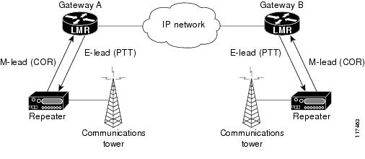
Digital (p25) set ups, you must define the following attributes for the channel to work properly.
  Receive Frequency
  Transmit Frequency
  NAC
Digital System Formats

Slide 31
NAC codes are user programmable and are typically used to control network access but may also be used to steer repeater functions . NAC codes minimize co-channel interference and allow repeater addressing by keeping the receiver squelched unless a signal with a matching NAC arrives.
When programming a digital channel you must define the NAC. Without the proper NAC code, the radio will not break squelch, nor will you reach the other party.
In many cases the default NAC code of 293 is used. This should not be changed unless your frequency information directly includes this information
** NAC codes must be defined for both RX and TX Frequencies.**
Digital Frequencies – NAC codes

Slide 32
As each conventional channel is defined by individual Receive and Transmit information, it is possible to have a Mixed Mode Channel.
RX Frequency 165.25 TPL None DPL None Mode Mixed NAC 293 | TX Frequency 152.625 TPL 110.9 DPL None Mode analog NAC 293
Conventional – Mixed Mode

Slide 33
Trunked Systems:
These are managed via the System Administrator - Trunked systems are tightly controlled and managed and not accessible by non-authorized personnel or radios.
Talk groups are a capability of trunked digital systems, When utilizing a talk group, you are accessing a community of users or sub-community of users on the system. Only those with the same talk group will be included in the conversation. The radio system itself actually assigned and manages the frequency information internally.
Talk Groups are a trunked feature and are not programed by the pilot.
P25
Conventional
Analog
Digital
Trunked
Trunked Systems - Talk Groups

Slide 34
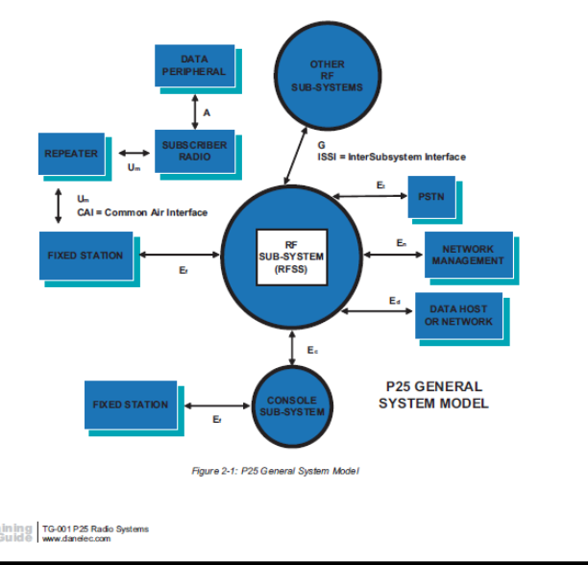
Todays P25 Trunked Radio systems
Standards Based –
Complicated Infrastructure
Conventional Systems
  Analog
  Digital
Trunked systems
Multiple access points
  Consoles
  Repeaters
Encryptions
(P25)

Slide 35
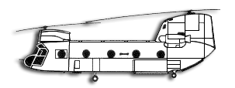

Direct Channels
Communication takes place via a direct
line of sight. Direct channel range may vary based on altitude of the aircraft in relation to surrounding terrain.
Using the System

Slide 36


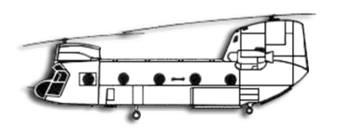

Repeaters are used in many areas to extend the range of subscriber radios. Repeaters are used in many cities to support radios across a large geographic area. Repeaters utilize Duplex channels exclusively and are the backbone of Trunked radio systems. If you are working on an 800Mhz system. Chance are very high you are accessing the systems repeaters.
Using Repeaters

Slide 37

Questions ?
Notes:
True Scalability –
All Technisonic Radios are based on a modular design …

Slide 38

TDFM-9000 Training Course

Slide 39
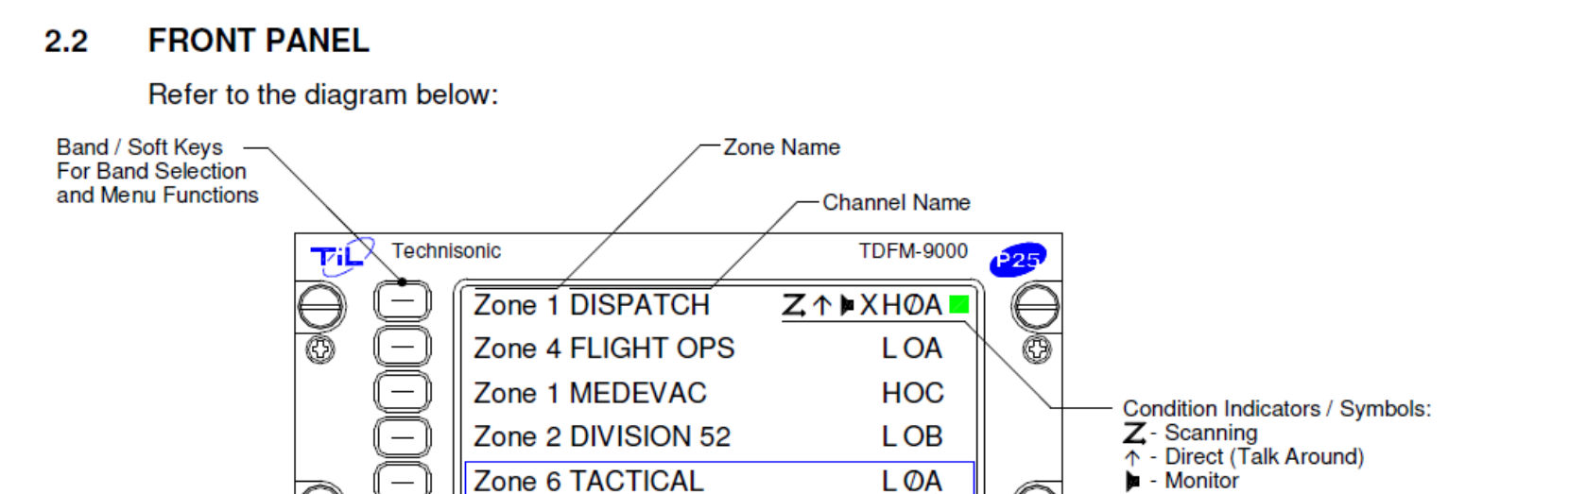
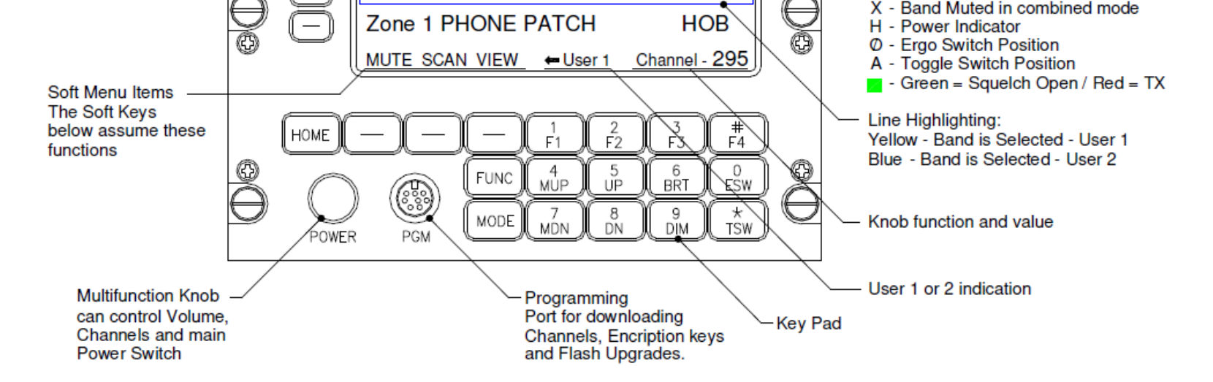
TDFM 9000 OPERATION

Slide 40
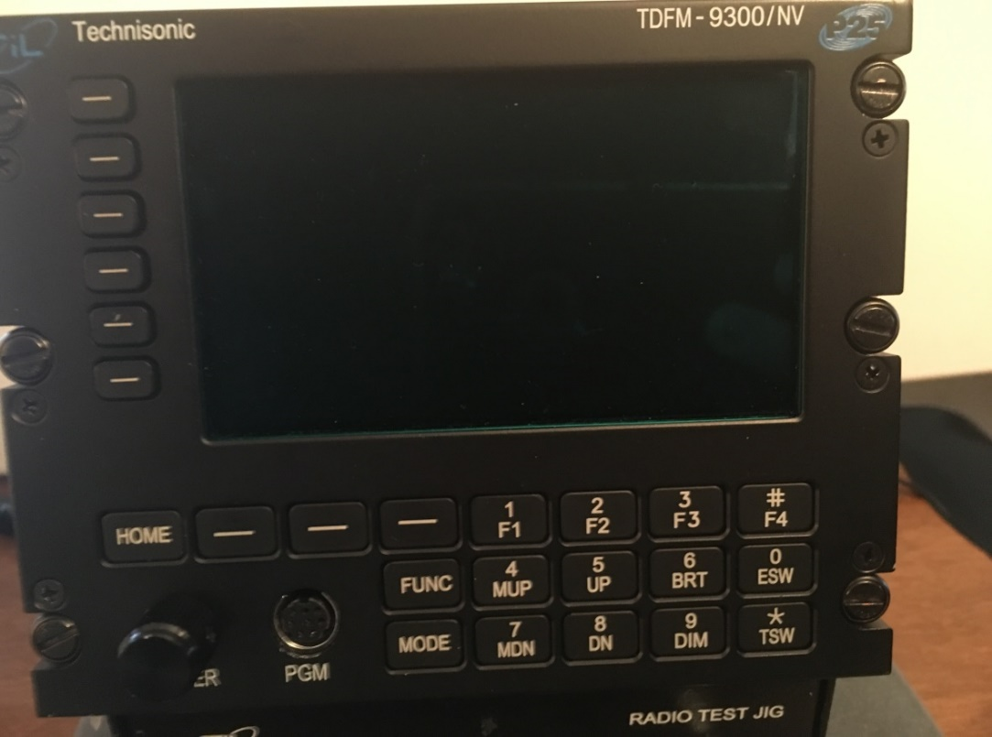
TDFM 9000 OPERATION
To turn the unit on:
Radio DOES NOT turn on automatically with aircraft power.
Push in on the Multimode knob for 1 to 2 seconds
NOTE: If the display remains dark after 30 seconds, press the “BRT” button a few times.
7/7/2022
TDFM-9000 ARNG H-60 Training
40

Slide 41

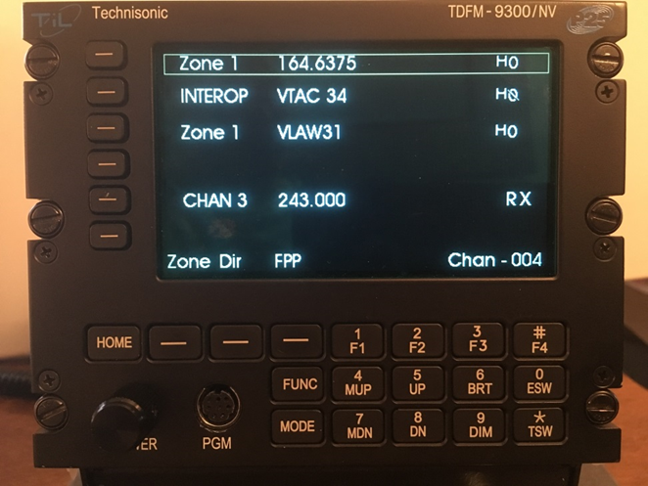

TDFM 9000 OPERATION
TDFM 9000 OPERATION
To set the display brightness:
Display brightness is manually set by the operator.
Press the “BRT” button to increase display brightness.
Press the “DIM” button to decrease display brightness.
The unit powers up at the brightness level it was at power down.
7/7/2022
TDFM-9000 ARNG H-60 Training
41

Slide 42

TDFM 9000 OPERATION
Module Selection
Selecting the module to transmit or update is accomplished by pushing the corresponding button next the desired module. The square box indicates which module is your transmit module as well as the module that all the buttons will manipulate.
7/7/2022
TDFM-9000 ARNG H-60 Training
42

Slide 43
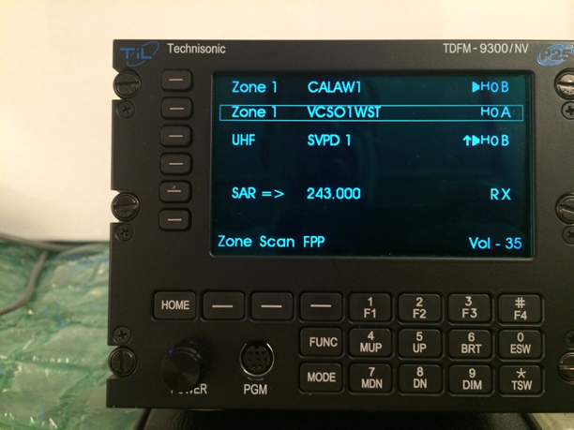
TDFM 9000 OPERATION
Setting Volume – “F4”
Press the Multimode knob so that “Vol” is shown in the lower right hand display.
Select the module by pressing the appropriate band select button. Then press F4 -Volume Set Tone. As long as F4 is pressed, the module will generate a tone in the headset that approximates normal voice volume level. Set the volume level by turning the Multimode knob.
NOTE if no tone is heard:
Make sure the audio panel volume knob is at its normal position
Make sure the module is not muted (Mute indicator is an “X” on the module line). Unmute by pressing the band select button once. The “X” will disappear.
7/7/2022
TDFM-9000 ARNG H-60 Training
43

Slide 44
TDFM 9000 OPERATION
Setting Volume – “F1”
For conventional analog channels, press the Multimode knob so that “Vol” is shown in the lower right hand display.
Select the module by pressing the appropriate band select button. Then press “F1” – Audio Unsquelch button. As long as F1 is pressed, the receiver will unsquelch . Set the volume level by turning the Multimode knob.
NOTE if no unsquelched audio is heard:
Make sure the audio panel volume knob is at its normal position
Make sure the module is not muted (Mute indicator is an “X” on the module line) Unmute by pressing the band select button once. The “X” will disappear.
7/7/2022
TDFM-9000 ARNG H-60 Training
44

Slide 45
TDFM 9000 OPERATION
Each of the 3 Modules has its own set of Preset Channels.
Channel memory is set up in multiple Zones (Banks) each with multiple Channels.
Zones have names with a total of 8 characters. Ex: “VHFFPP”, “MARINE”.
Channels have names with a total of 14 characters. Ex: “ICALL”, “MARINE01”
7/7/2022
TDFM-9000 ARNG H-60 Training
45

Slide 46

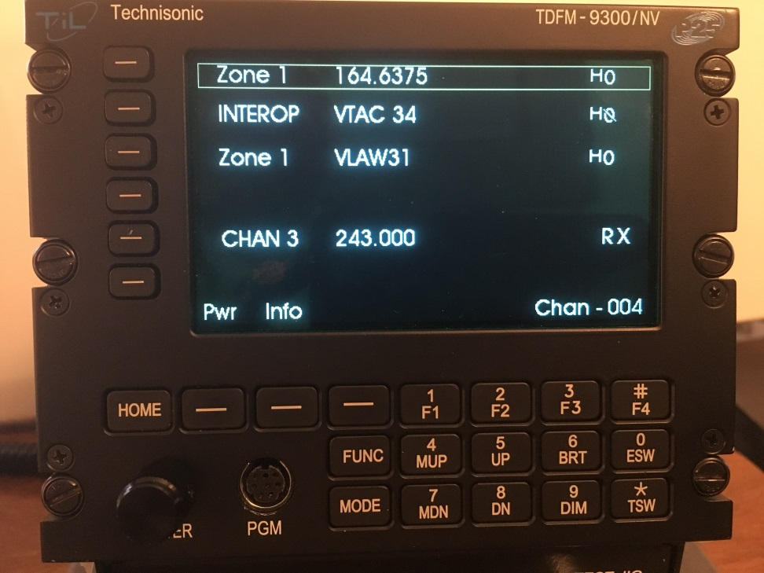
TDFM 9000 OPERATION
Soft Keys
Their functions correspond to the above labeled options. There can be 9 options that can be controlled by the Up (5) & DN (8) buttons stepping thru 3 options at a time.
7/7/2022
TDFM-9000 ARNG H-60 Training
46

Slide 47
TDFM 9000 OPERATION
Soft Keys for VHF (Module 1)
“ZONE” allows for changing zones to find desired Channel
“PWR” allows the operator to select between low or high transmit power.
“FPP” enter conventional channel directly through the radio's front panel, via the radio's menu navigation and keypad buttons
“INFO” view basic radio information such as IP-related information and buttons / switches control mapping,
7/7/2022
TDFM-9000 ARNG H-60 Training
47

Slide 48
TDFM 9000 OPERATION
Soft Keys for UHF (Module 2) & 800/VHF (Module 3)
“ZONE” allows for changing zones to find desired Channel
“PWR” allows the operator to select between low or high transmit power.
“INFO” view basic radio information such as IP-related information and buttons / switches control mapping,
7/7/2022
TDFM-9000 ARNG H-60 Training
48

Slide 49

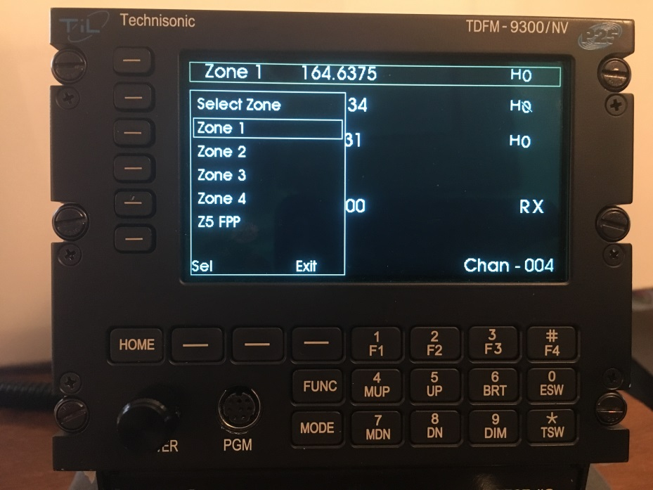
TDFM 9000 OPERATION
Changing to a desired Zone
Press the “Zone” soft key and the above menu appears
Rotate the knob to move the highlighted box to the desired zone
Press the “Sel” soft key to select that zone
7/7/2022
TDFM-9000 ARNG H-60 Training
49

Slide 50

TDFM 9000 OPERATION
TDFM 9000 OPERATION
Changing to a desired Channel
Use the “MUP”(4) or “MDN”(7) keys to scroll thru channels within the selected zone.
Press the Multi-mode knob so that “Chan” is displayed in lower right of display. Then rotate knob to change channel.
7/7/2022
TDFM-9000 ARNG H-60 Training
50

Slide 51
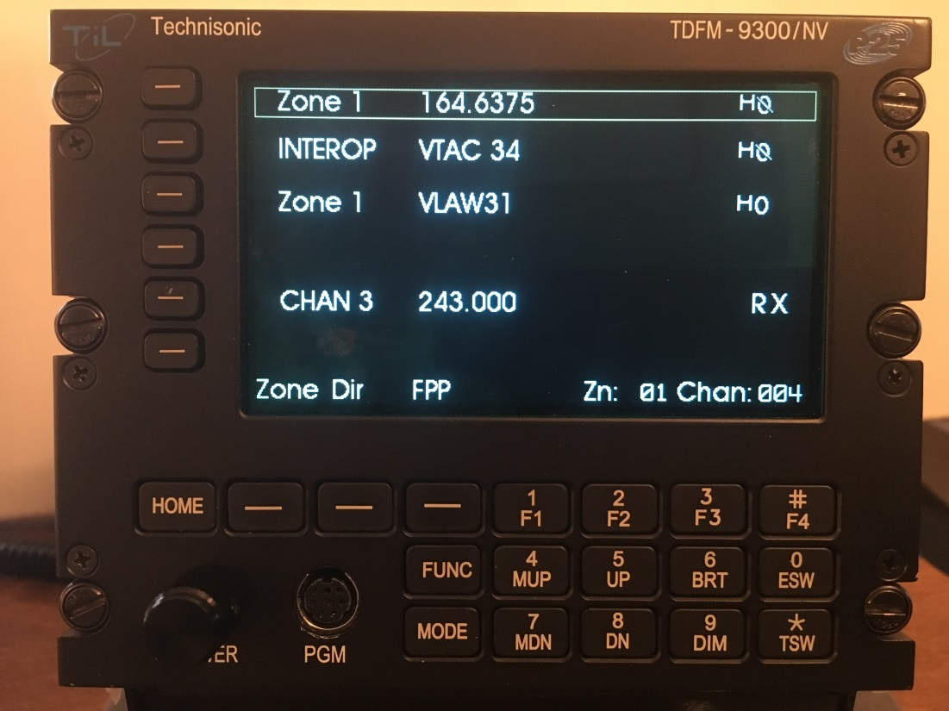
TDFM 9000 OPERATION
TDFM 9000 OPERATION
Third way is to push the Multimode knob to display Zn:xxx Chan:xxx in the lower right corner.
Then enter in the desired 3 digit Zone and the 3 digit Channel. The radio will automatically jump to that Zone & Channel.
NOTE: This function may be disabled during setup/configuration.
7/7/2022
TDFM-9000 ARNG H-60 Training
51

Slide 52
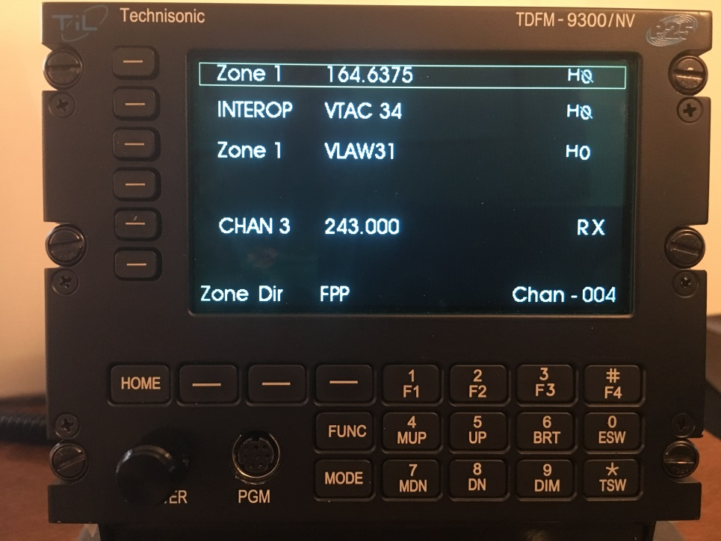
TDFM 9000 OPERATION
TDFM 9000 OPERATION
Encryption Switch (ESW), Toggle Switch (TSW), F2, F3
Both are disabled at this time. Can be re-enabled via CPS.
“ESW” Normally controls encryption on/off.
“TSW” can control user selectable functions set in CPS.
“F2” and “F3” can control user selectable functions set in CPS.
7/7/2022
TDFM-9000 ARNG H-60 Training
52

Slide 53
TDFM 9000 OPERATION
TDFM 9000 OPERATION
“FPP” Front Panel Programming
This optional feature allows a crew member to modify a channel on the fly without Motorola CPS software. It can only be a conventional channel. No trunking.
NOTE:
1) ONLY MODULE 1 (VHF) has FPP capability.
2) ONLY the zone named “VHFFPP” has this capability.
3) 32 channels have been setup in this zone for you to use.
4) You may use FPP mode to LOOK at channels in other zones on Module 1 (VHF) but you will NOT be able to CHANGE what is programmed in those zones.
7/7/2022
TDFM-9000 ARNG H-60 Training
53

Slide 54
TDFM 9000 OPERATION
FPP (Front Panel Programming)
Module 1 FPP
Trunking Channel
Stop – you have no hope
Conventional
Analog (non-ASTRO)
Digital (ASTRO)
RX Frequency
RX Tone (None, PL, DPL)
TX Frequency
Tx Tone (None, PL, DPL)
RX Frequency
TX Frequency
RX NAC Code
TX NAC Code
Talk Group

Slide 55

TDFM 9000 OPERATION
TDFM 9000 OPERATION
“FPP” Front Panel Programming
Select module 1 zone “VHFFPP”
Then select channel you wish to modify (1-32)
Press the “FPP” soft key to enter the “FPP” programming mode
7/7/2022
TDFM-9000 ARNG H-60 Training
55

Slide 56
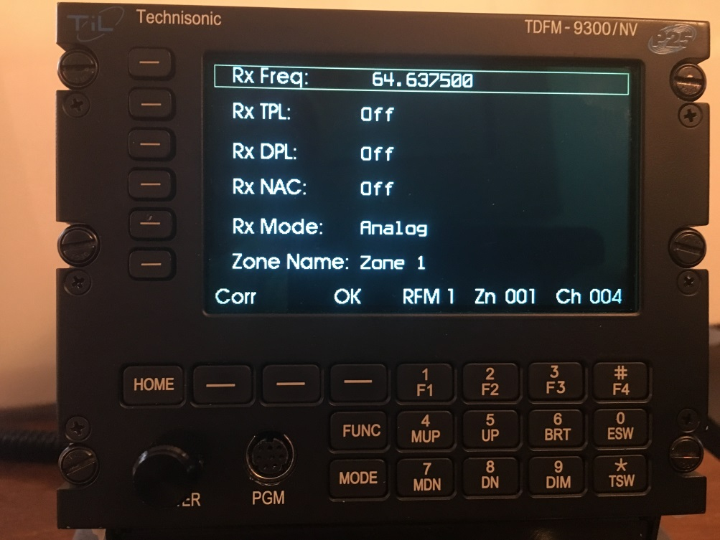
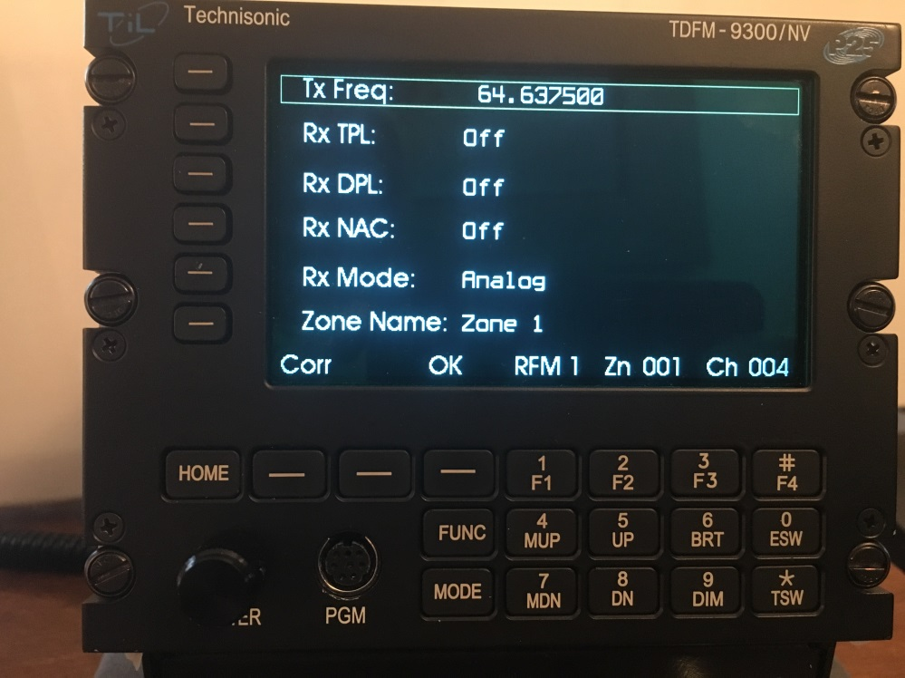
TDFM 9000 OPERATION
TDFM 9000 OPERATION
FPP-The box will first appear over “RX Freq”. Input your RX Freq. Then press “OK” to accept and the radio will toggle over to “TX Freq”. Input TX Freq and press “OK” to accept
NOTE:
You MUST press the “OK” softkey in order for the data to be stored!!!!!
7/7/2022
TDFM-9000 ARNG H-60 Training
56

Slide 57
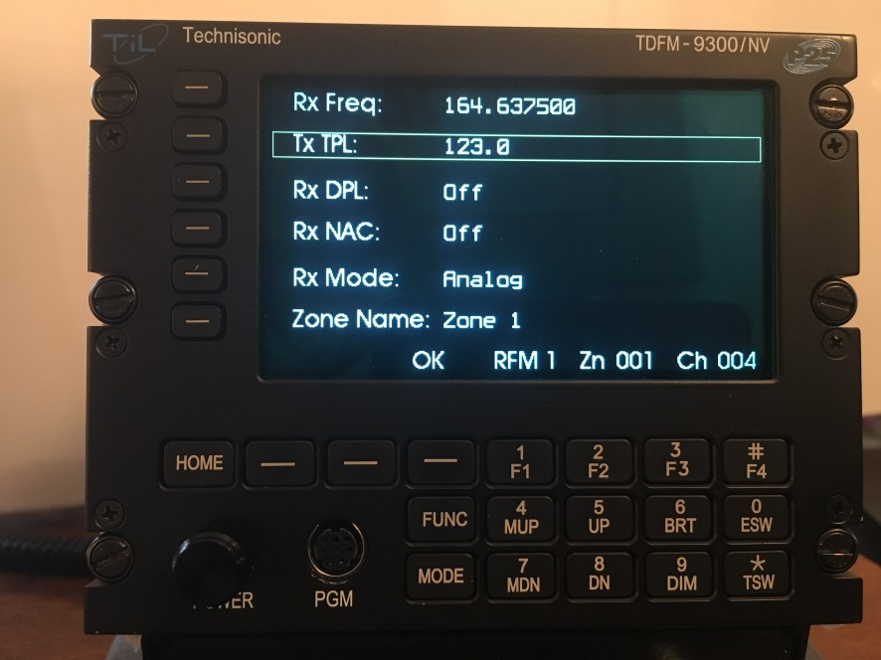
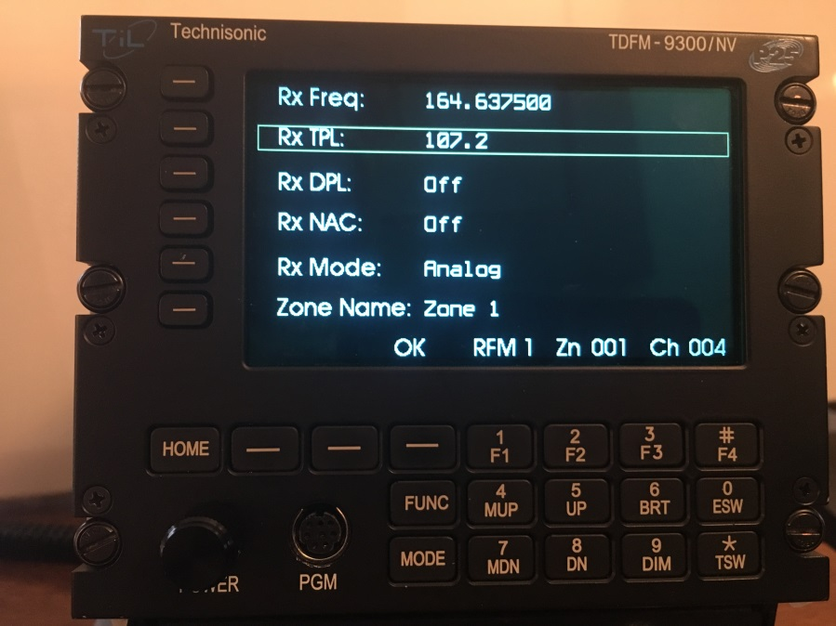
TDFM 9000 OPERATION
TDFM 9000 OPERATION
“RX TPL” (Tone Private Line), If required to add, push corresponding side button and rotate the knob for the desired PL tone, then press “OK” to accept and it will switch over to “TX TPL”. Again rotate knob for desired PL tone, then press “OK” to accept.
7/7/2022
TDFM-9000 ARNG H-60 Training
57

Slide 58
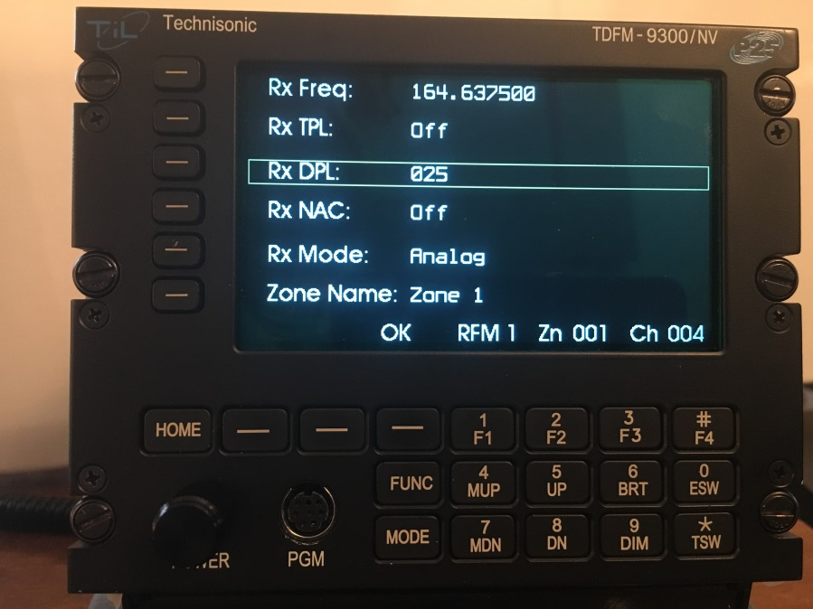
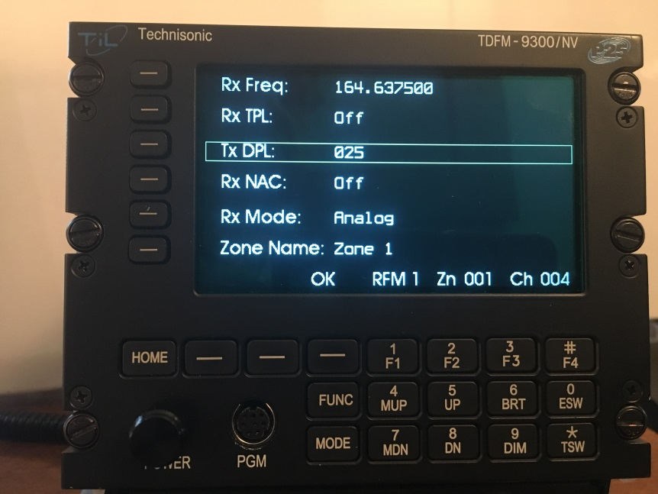
TDFM 9000 OPERATION
TDFM 9000 OPERATION
“RX DPL” (Digital Private Line), If required to add, push corresponding side button and rotate the knob for the desired PL tone, then press “OK” to accept and it will switch over to “TX DPL”. Again rotate knob for desired PL tone, then press “OK” to accept.
7/7/2022
TDFM-9000 ARNG H-60 Training
58

Slide 59
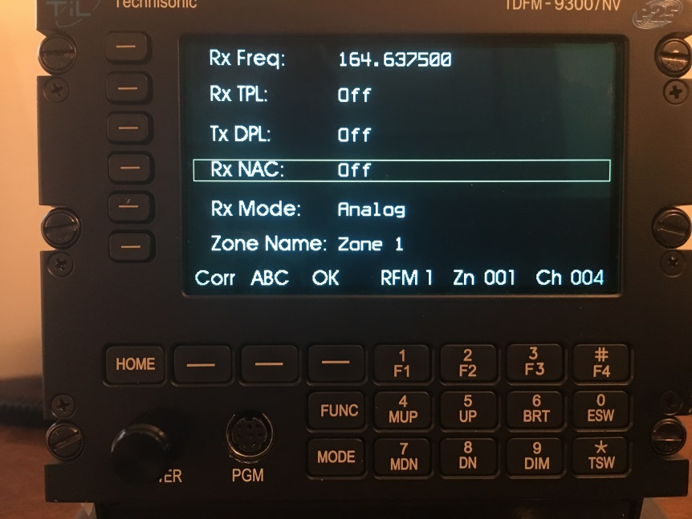
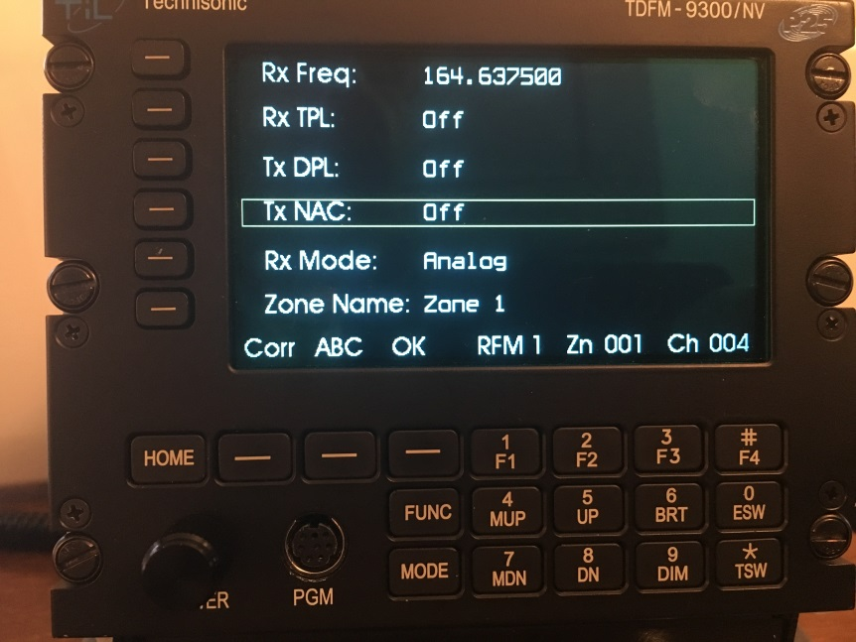
TDFM 9000 OPERATION
TDFM 9000 OPERATION
If a NAC (Network Access Code) is desired, Push the corresponding button for RX NAC, then rotate the knob for the 3 digit hexadecimal number. Then click “OK” to accept. Repeat for TX NAC
7/7/2022
TDFM-9000 ARNG H-60 Training
59

Slide 60
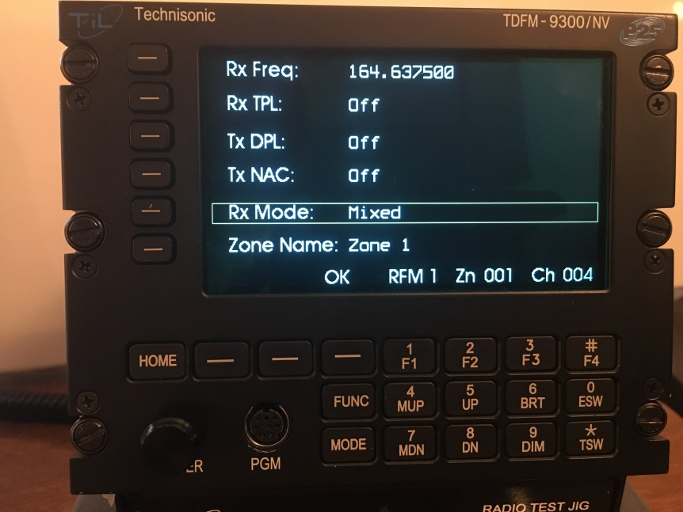
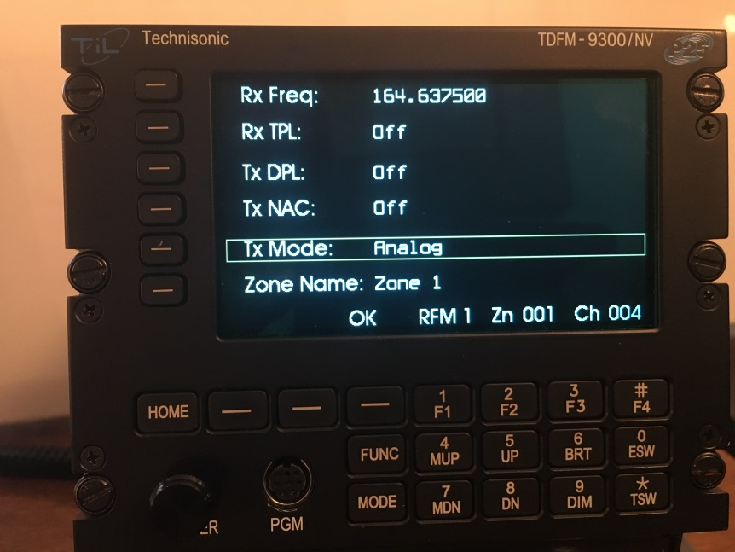
TDFM 9000 OPERATION
TDFM 9000 OPERATION
RX Mode, Press the corresponding button next to “RX Mode”, Rotate the knob to select between Analog, Mixed, or Digital, press “OK” to accept and switch to “TX Mode”, again rotate knob to accept Analog or Digital, Press “OK” to accept
7/7/2022
TDFM-9000 ARNG H-60 Training
60

Slide 61
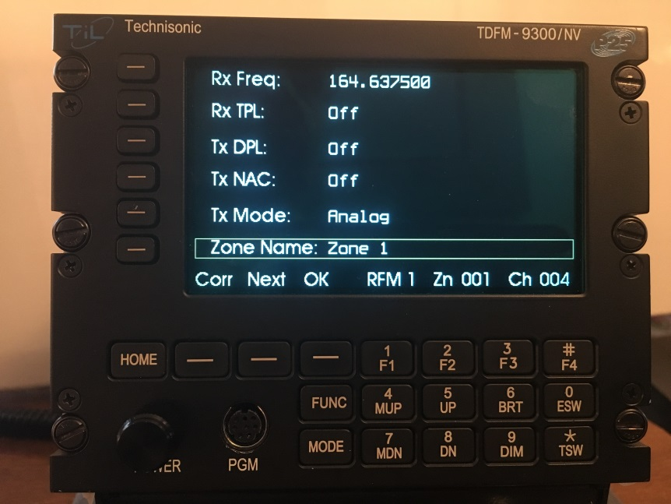
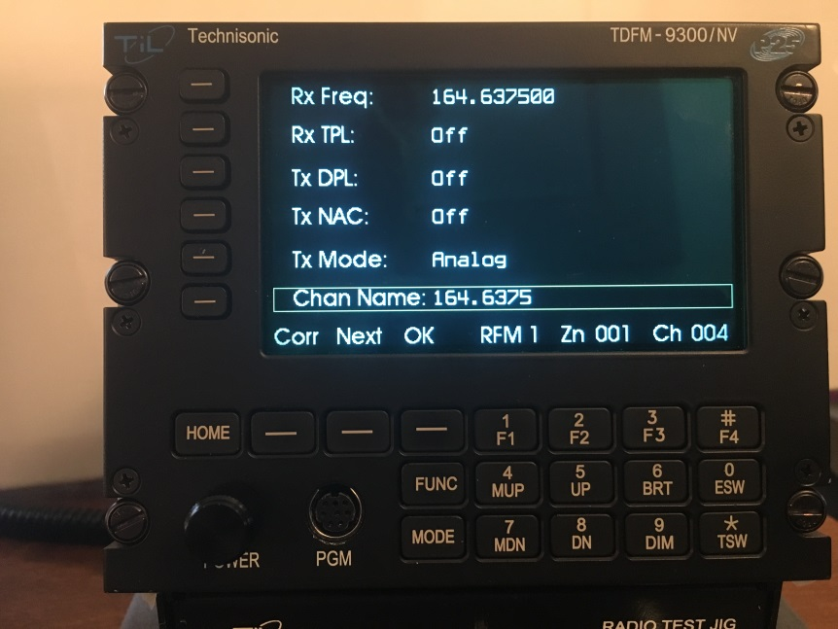
TDFM 9000 OPERATION
TDFM 9000 OPERATION
If wanting to change the Zone name, Rotate the knob to change A,B…1,2…, Then press the next key to advance to the next position. Once complete, hit the “OK” soft key- Advise not changing Zone Name
Push the Button next to “Zone Name” to proceed to “Chan Name”. Repeat the previous steps to change the “Chan Name”. Once complete, Hit the “OK” soft key
7/7/2022
TDFM-9000 ARNG H-60 Training
61

Slide 62
TDFM 9000 OPERATION
TDFM 9000 CROSSBAND REPEATER
You can select any two modules to cross band repeat. The repeat function is semi-duplex. This means the radio will retransmit from one module to another in both directions but not simultaneously. This is between modules not bands within the same module.
7/7/2022
TDFM-9000 ARNG H-60 Training
62

Slide 63
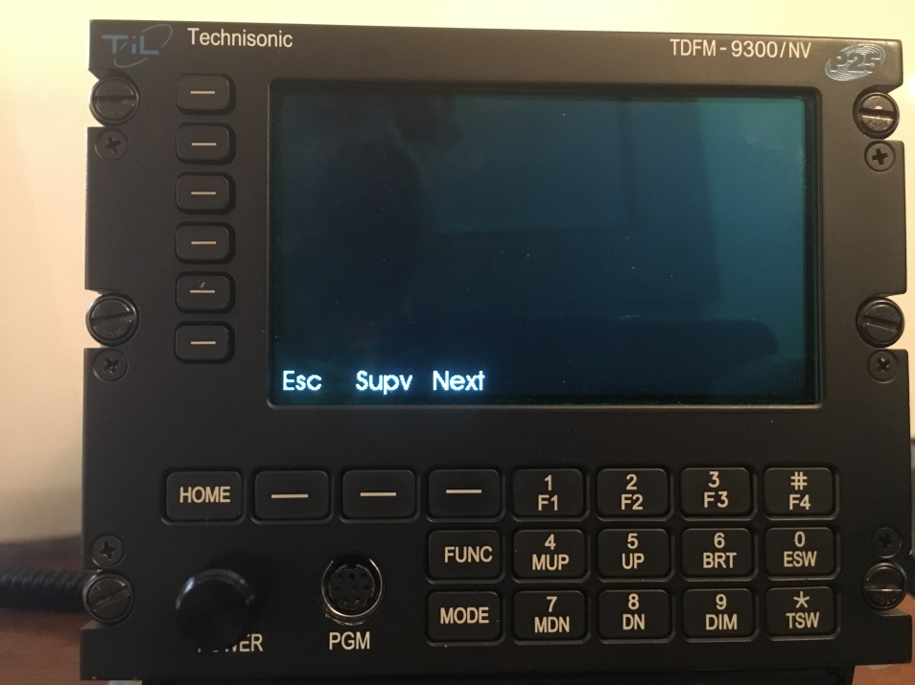
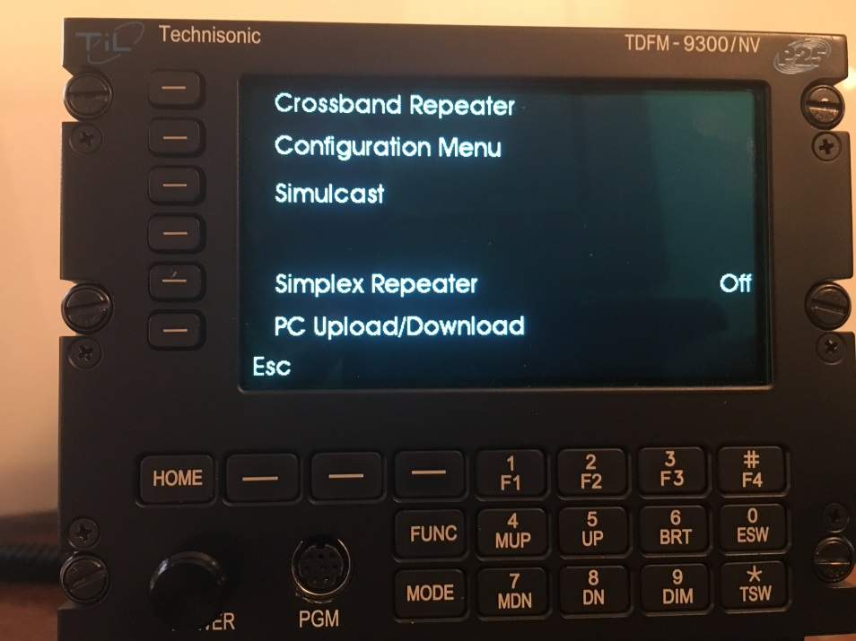
TDFM 9000 OPERATION
TDFM 9000 CROSSBAND REPEATER
To select Crossband Repeat, Press the “Func: key, then press the “Next” key.
7/7/2022
TDFM-9000 ARNG H-60 Training
63

Slide 64
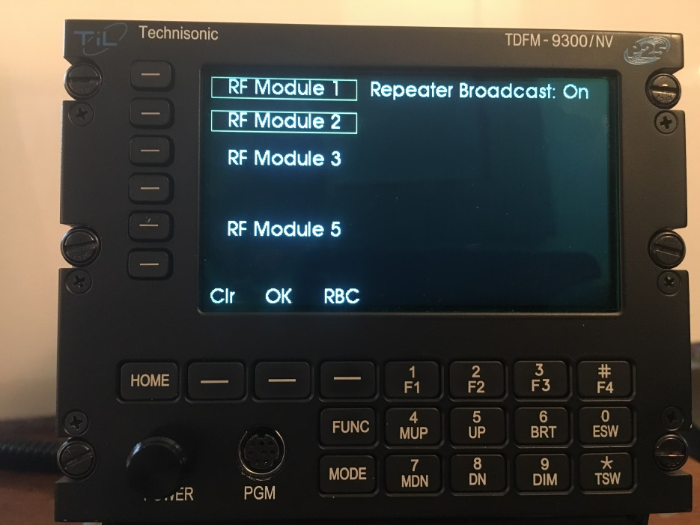
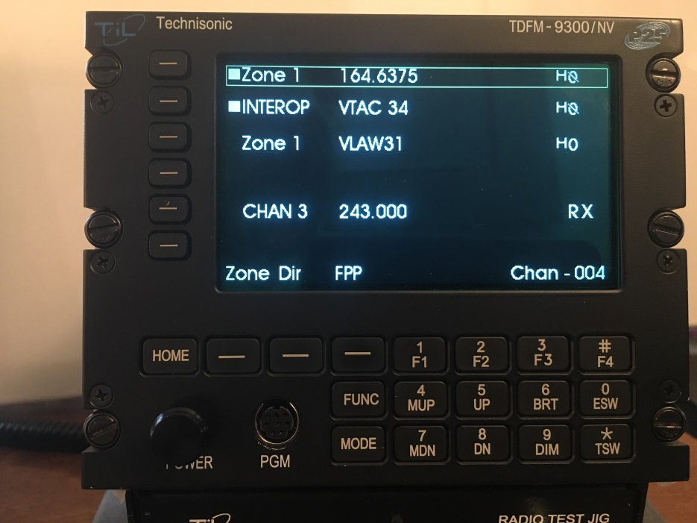
TDFM 9000 OPERATION
TDFM 9000 CROSSBAND REPEATER
Press the “Cross-band Repeater” button, Then select the two modules to be cross-banded, then press “OK”. Two solid squares will display next the modules selected.
7/7/2022
TDFM-9000 ARNG H-60 Training
64

Slide 65
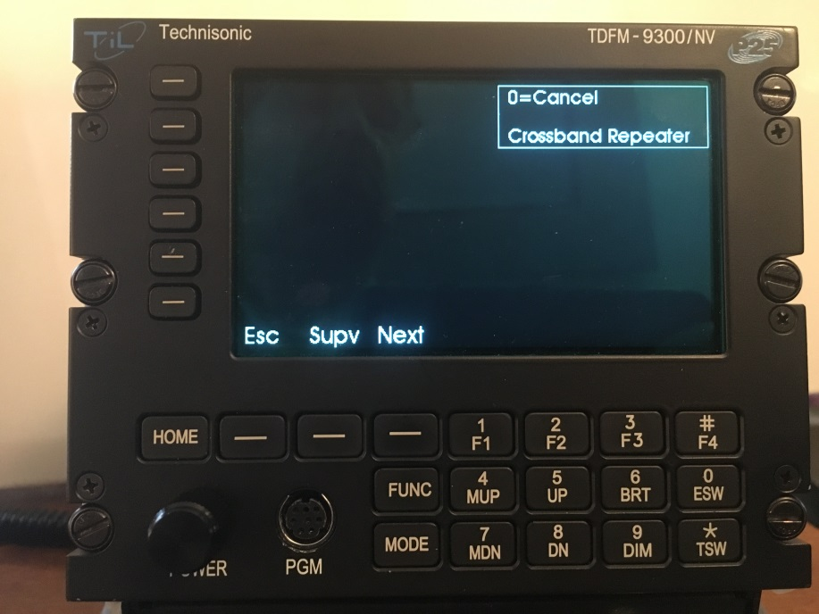
TDFM 9000 CROSSBAND REPEATER
TDFM 9000 OPERATION
To clear Crossband Repeat, press the “FUNC” key. Then press the “ZERO” key to cancel the mode.
7/7/2022
TDFM-9000 ARNG H-60 Training
65

Slide 66
TDFM 9000 OPERATION
TDFM 9000 SIMULCAST
You can select 2 or more modules to transmit simultaneously. Simulcast is only available when using the one or both of the combined input/outputs. Simulcast can be used in conjunction with the cross band repeat mode
7/7/2022
TDFM-9000 ARNG H-60 Training
66

Slide 67
TDFM 9000 OPERATION
TDFM 9000 SIMULCAST
To select “Simulcast”, Press the “FUNC” key, then press the “Next Key
7/7/2022
TDFM-9000 ARNG H-60 Training
67

Slide 68
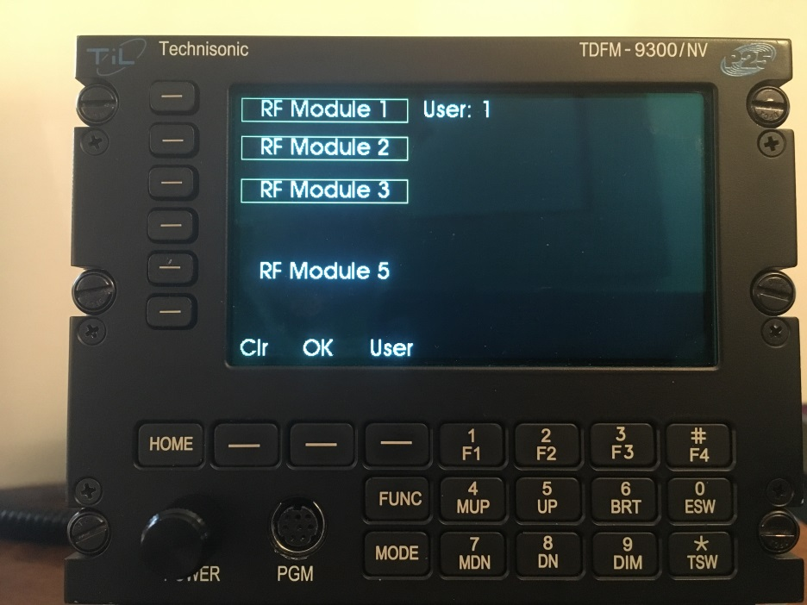
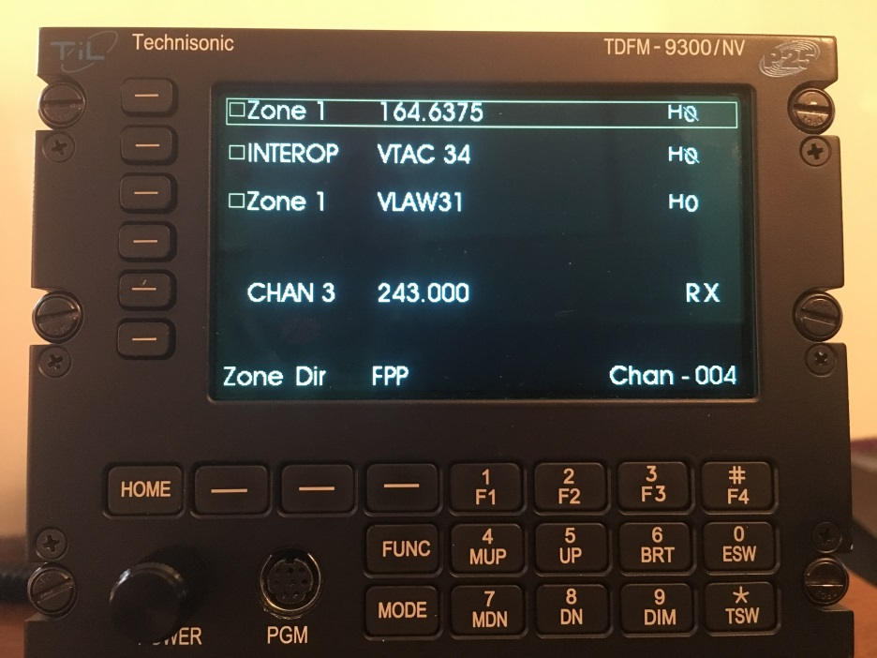
TDFM 9000 SIMULCAST
TDFM 9000 OPERATION
Press the “Simulcast” button, then select the “Modules” to be simulcast on, then press “OK”. Hallow Squares will appear next to the selected modules.
7/7/2022
TDFM-9000 ARNG H-60 Training
68

Slide 69
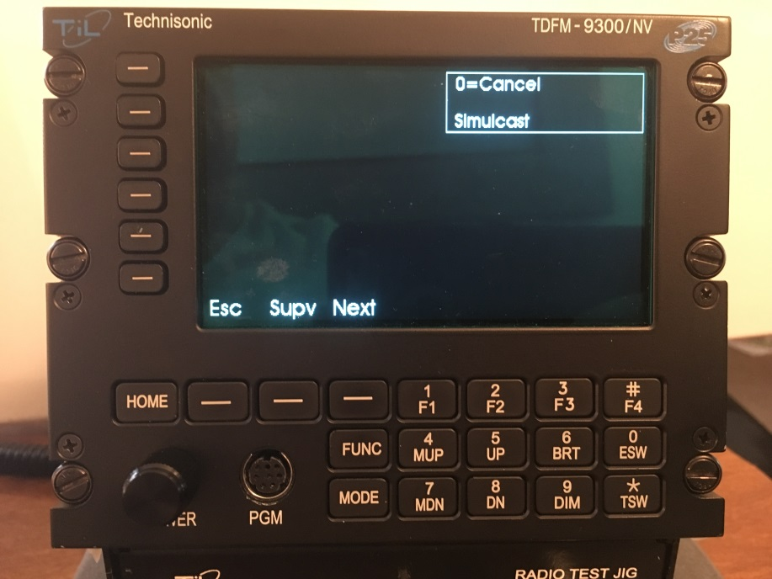
TDFM 9000 OPERATION
TDFM 9000 SIMULCAST
To clear Simulcast, press the “FUNC” key. Then press the “ZERO” key to cancel the mode.
7/7/2022
TDFM-9000 ARNG H-60 Training
69

Slide 70

Builds and Capabilities

Slide 71

TDFM 9000 OPERATION
CPS Customer Programming Software
Notes:
True Scalability –
All Technisonic Radios are based on a modular design …

Slide 72
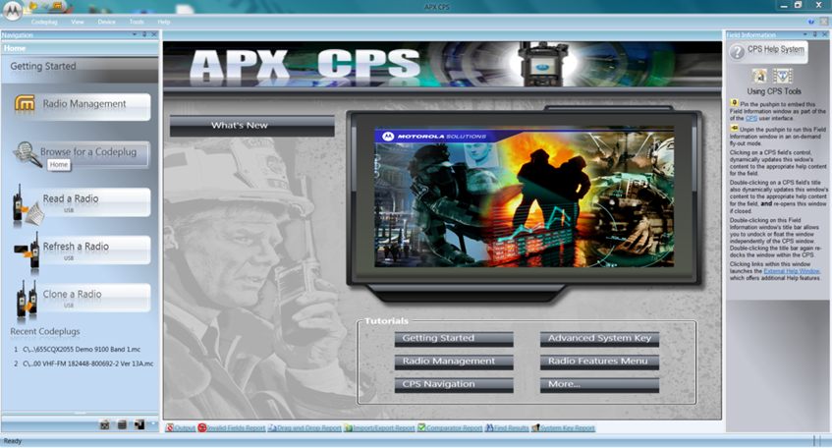
Intro to Motorola CPS

Slide 73
CPS Programming - 101
Motorola modules must be programmed with a program called “APX CPS” which stand for “APX Customer Programming Software”.
Revision of CPS is VERY IMPORTANT. Once a module is programmed with a revision of CPS, you cannot program it with an older revision of CPS!!!!

Slide 74
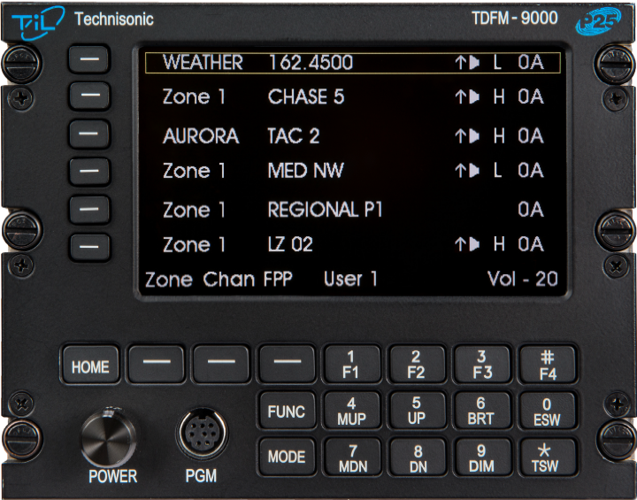
CPS Programming – Read a Module
Power-up the TDFM-9000.
Connect the cable (TiL P/N 127499 “PC-9000 “) between the programing port on the front of the TDFM-9000 and your computer.
Select which band you want to read by pressing one of the band select soft buttons.

Slide 75
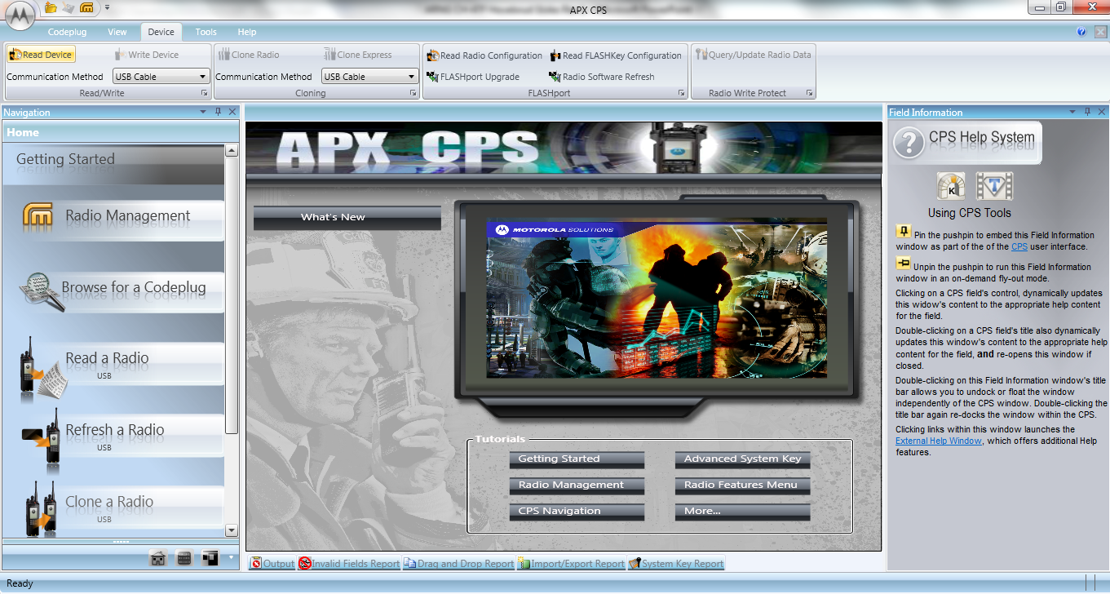
CPS Programming – Read a Module
Select “Read a Radio” button on the CPS opening page or “Read Device” under the Device tab (both highlighted above) then follow additional instructs of CPS to start the process.
TDFM-9000 band selected for reading will display “Programming” once the process begins
CPS will indicate the status of the process.

Slide 76
CPS Programming – Warning!!!!
!!!!Warning!!!!
Do NOT unplug the cable during a CPS Read or Write Operation – bad things can happen to the module

Slide 77
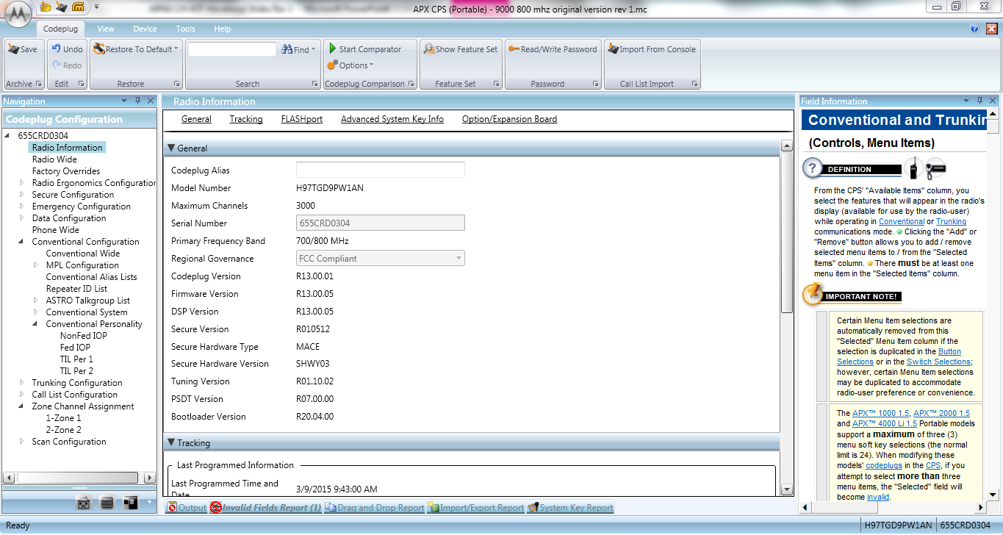
CPS Programming – Read a Module
When the read process is complete, CPS will display something similar to the above. The codeplug is now ready to be modified.

Slide 78

CPS Programming – Saving Codeplug
To save a Codeplug after reading or after making changes, click on the “M” button and select “Save” or “Save As”.

Slide 79

CPS Programming – Write to a Module
To write a codeplug into a module, on the “Device” tab either select “write”(if the codeplug is originally from the module, or “Clone” or “Clone Express” if the codeplug is going into a different module.
TDFM-9000 band selected for reading will display “Programming” once the process begins and CPS will indicate the status of the process.

Slide 80
CPS Programming – Warning!!!!
!!!!Warning!!!!
Do NOT unplug the cable during a CPS Read or Write Operation

Slide 81
CPS Programming – Screenology
Configuration Tree
Codeplug Information
Help Information

Slide 82
CPS Programming – Configuration Tree
The Configuration Tree window lists all the major sections of the codeplug. If you click on one of the sections, it causes the Data Information window to display the info for that section.
To add, delete, or rearrange preset channels, you will need to access the “Personality” and “Zone Channel Assignment” nodes.
Other nodes are usually “set and forget”. However, if a codeplug is ever sent out to another programmer, you need to check that they didn’t mess with anything they shouldn’t have like Buttons and soft menu items.

Slide 83

CPS Programming – Radio Information Window
Radio Information window displays the data contained in the node that is selected in the Configuration Tree. This is where you input the actual information into the program.

Slide 84

CPS Programming – Field Information Window
Field Information window displays Help information associated with the field your cursor in on in the Radio Information window.
If you want to know more about the field your cursor is located, look over in this window and it will tell you all about the field. It also has links to other terms that may help you figure out what you need to do.

Slide 85

Radio Ergonomics -
Radio Ergonomics
Allows you to customize the Buttons, Switches and Menu items to support your specific needs and functionality

Slide 86

Essential Elements – Soft Keys
MENU Items
Menu Items are displayed as the SOFT KEYs on the TDFM Series radio.
Soft keys are ideal to access common functions such as Zone, FPP, Scan, Pwr, Mute and Info
Keys Are shown in order 3 at a time, to cycle simply press the 5 (up) or 8 (dn) buttons.

Slide 87

Essential Elements – Buttons
Buttons
Button Settings utilized one the radio ad the F1, F2, F3, F4 keys
Side Top Button = F1
(Monitor, opens the receive PL Tone)
Top Button = F4
(Vol Set Tone)
Side Middle Button = F2
(MS01 Quick Save )
Side Bottom Button = F3
(MS02 Quick Save)

Slide 88

Essential Elements – Switches
Switches – ESW / TSW
The Concentric Switch
Position A and Position B are most commonly utilized to
Access Encryption and are via the ESW or the 0 key on the TDFM.
Toggle Switches are accessed Via the TSW or * key and are displayed as position A, B, or C. These switches are easily overlooked by Crew in high workload environments, Careful consideration should be exercised prior to their programming.

Slide 89

Essential Elements - Hidden Dangers
BEWARE: Some commonly selected options hold a hidden danger –
THEY ARE GLOBAL IN NATURE: With NO indication of their selection shown on the display
These options while selected on a channel basis, Revert all channels on that module to the selected feature:
DIR - Direct or Talk Around - Selecting DIR will place ALL REPEATER CHANNELS into the DIRECT MODE –
PL TONE DISABLE: All PL Tones will be disabled on that module;

Slide 90

CPS Programming - Programming a Channel
Step 1: Select a Personality in the Navigation Window

Slide 91
CPS Programming - Programming a Channel
Step 1: Select a Personality
Step 2: Input Frequency Options
Step 3: Assign the Frequency to a Zone and Channel

Slide 92
CPS Programming - Programming a Channel
Step 1: Select a Personality
Step 2: Input Frequency Options
Step 3: Assign the Frequency to a Zone and Channel

Slide 93
CPS Programming
Program Personality
Trunking Channel
Stop – you have no hope
Conventional
Analog (non-ASTRO)
Digital (ASTRO)
RX Frequency
RX Sq (CSQ, PL, DPL)
RX PL/DPL Tone Number
TX Frequency
Tx Tone (none, PL, DPL)
TX PL/DPL Tone Number
RX Frequency
TX Frequency
RX NAC Code
TX NAC Code
Talk Group

Slide 94

Configuration Management
Configuration Menu
The TDFM-9000 has within its operating Software, a configuration Menu. This menu is used by installation and avionics personnel to properly config the radio for its environmental and user needs. This configuration Menu , once set can be locked via a supervisory passcode feature.
To access the Configuration Menu.
From the standard operational screen, Press
FUNC Next Then press the Select Button next to the Configuration Menu item on the screen
Notes:
True Scalability –
All Technisonic Radios are based on a modular design …

Slide 95

N I F O G Code Plug
Notes:
True Scalability –
All Technisonic Radios are based on a modular design …

Slide 96
National Interoperability Field Operations Guide NIFOG
NIFOG
Notes:
True Scalability –
All Technisonic Radios are based on a modular design …

Slide 97
National Interoperability Field Operations Guide NIFOG
NIFOG
THE NATIONAL INTEROPERABILITY FIELD OPERATIONS GUIDE:
What is the “National Interoperability Field Operations Guide”?
The “National Interoperability Field Operations Guide” (N I F O G) is a pocket-sized listing of land mobile radio (LMR) frequencies that are often used in disasters or other incidents where radio interoperability is required, and other information useful to emergency communicators.
Notes:
True Scalability –
All Technisonic Radios are based on a modular design …

Slide 98
National Interoperability Field Operations Guide NIFOG
NIFOG
As part of the implementation of the TDFM-9000 in all aircraft, Technisonic will make avialable upon request a developed “Code-Plug” that is inclusive of all: Federal VHF, UHF, and 7-800Mhz NIFOG Frequencies.
The purpose of this initial code plug is to ensure that all units begin with a common frequency capability and lay-out. This effort should, the aircraft be dispatch in response to domestic emergency's, such as Hurricanes, Flooding, Tornado and other natural disaster, it will be able to field immediately utilizing the federal frequencies as defined by FEMA.
In addition to the FEMA frequency guidance, the Initial code plug is also inclusive of
Common WX, Marine Radio, and US Forest Service Guard Frequencies.
Notes:
True Scalability –
All Technisonic Radios are based on a modular design …

Slide 99
National Interoperability Field Operations Guide NIFOG
NIFOG
Components:
Copy of the May 2015 NIFOG Booklet
TDFM-9000 Code Plugs for
  Module #1 VHF
  Module #2 UHF
  Module #3 VHF / 7-800
3) Cockpit Cards
Notes:
True Scalability –
All Technisonic Radios are based on a modular design …

Slide 100


Evolution
Software and Capability
Updates
Notes:
True Scalability –
All Technisonic Radios are based on a modular design …

Slide 101

Evolution
You Spoke, Technisonic Listened, Version 2.2.6 Software –
* Added a config menu that allows the knob direction to be changed when the alternate menu is displayed.
* Added a config menu that allows the "Combined Mute Indicator" (X) to be turned off. Combined mute still functions but the indicator can be turned off for use when the radio is wired for separate mode
Added a Timer Revert function for the Recall menu.
Added a timer Revert to Num Lock Mode.
Added Color Selection for each Module
Added Channel Only, Zone Only, or Channel /zone selection to recall Mode.
Glare Timer - “ ADMIN TIMER” When display is set to FULL BRT, a timer can be set to temporarily brighten the screen to overcome Glare and reflections.
Notes:
True Scalability –
All Technisonic Radios are based on a modular design …

Slide 102
You Spoke, Technisonic Listened, Hardware Updates
Evolution
Developed a Hardened Lens for the TDFM-9000 - New lens provides the same performance as the original but has been hardened to resist unintentional impacts. (Not Unbreakable, but much tougher to do!) Factory Standard on all new radios as of June 2018
New Dust Cover Solution for Keypad will be available Summer of 2019. Protect the radio from dust and dirt intrusion in doors off and high dust environments.
Notes:
True Scalability –
All Technisonic Radios are based on a modular design …

Slide 103
Evolution
TECHNISONIC ANNOUNCES ITS NEWMULTI-PURPOSE COMMUNICATIONS PORT CAPABILITY in TDFM-9000 /9100
MCP is the next leap in airborne communications integration. This disruptive new technology makes communication systems integration possible through a series of dedicated communications ports on the TDFM-9000 series radios. Developed to address circumstances where additional temporary capabilities are needed such as handhelds, or where additional communication integrations are mission-critical such as Satellite, MCP Technology provides a unique set of capabilities that can now be leveraged by TDFM-9000 series operators to further expand and support their changing mission requirements without need for wholesale replacement of existing systems.
Notes:
True Scalability –
All Technisonic Radios are based on a modular design …

Slide 104
Evolution - Multi-Purpose Communications Ports
TECHNISONIC ANNOUNCES ITS NEWMULTI-PURPOSE COMMUNICATIONS PORT CAPABILITY in TDFM-9000 /9100
Developed in response to customers’ requests, Technisonic has significantly improved the TDFM-9000 /9100's by expanding the platform's capability to fully support an additional two (2) external communications devices beyond the radio's internal All-band FM modules.
Moto-turbo, Harris, PRC and Satellite communications are just some of the product lines our customers have requested be supported.
Notes:
True Scalability –
All Technisonic Radios are based on a modular design …

Slide 105

Resources
Notes:
True Scalability –
All Technisonic Radios are based on a modular design …

Slide 106

Resources
Support Tab Holds all certification, Software and support information available for download free of charge.
Notes:
True Scalability –
All Technisonic Radios are based on a modular design …

Slide 107

Resources- Product Pages
Product specific resources such as manuals, drawings, firmware and the like can be found one the specific product page on the til.ca website
Download TDFM-9000 Brochure (480 KB)
Download TDFM-9000 Installation Instructions (Rev. D, Issue 4) (10.2 MB)
Download TDFM-9000 Operating Instructions (Rev. F for Version 2 Software) (14.8 MB)
Download TDFM-9000 Operating Instructions (Rev. C for Version 1 Software) (9.1 MB)
Download APX CPS Programming Software/Cables Ordering Guide (43 KB)
Download TDFM-9000 3D-CAD (.Step) File (6.9 MB)
Download APX CPS Software and Programming Cable Guide
Download MCP Brochure (480 KB)
Notes:
True Scalability –
All Technisonic Radios are based on a modular design …

Slide 108

Personal Support Resources
Technisonic is proud to provide the very highest level of support for our products, customers, and operators. Our commitment to our support is the driving company principle. From exceptional initial quality, to Telephone, and Onsite field support, to Programming and End User training. Technisonic ensures your customers receive the very highest level of support, leading to the very best experience and approvals of Technisonic products and personnel.
Jim Huddock Jon Rorke
Dir Business Development Factory Technical (Motorola)
Technisonic Technisonic
(612) 231 9020 (905)890-2113 X 203
jhuddock@til.ca jonr@til.ca

Slide 109

Field Approved Software Updates
TDFM-9000 /9300 /9200 Current Production Software
Main Code Update: Software 11S151M V2.2.6 MAIN SW
11S152K JM60/APX INTERFACE SW. V2.2.6.

Slide 110
Firmware Updates - Technisonic Firmware Procedure
Performing Update:
Installations Instructions

Slide 111


THANK YOU ALL
Notes:
Developed as the natural progression for our industry leading TDFM-7300 series radio,
The ALL New 9000 series radios – maintain the same size and dimensions of the 7300,
replacement, or cockpit commonality simple –
while providing an unparalleled leap in capability

